Slide 1
JDI intro

Slide 2

PLAN
JDI Intro
JDI UI objects and Complex elements
JDI Tables and custom elements
JDI Settings. EDT. DDT. Test runs
Around JDI. Reports. Logs. Grid. Asserts

Slide 3
AGENDA
JDI 101
Simple elements
JDI Locator and annotations
Examples

Slide 4
JDI 101

Slide 5





Jdi setup
https://github.com/epam/JDI
http://jdi.epam.com/
https://vk.com/jdi_framework
README

Slide 6
Jdi setup
TEMPLATE
https://github.com/epam/JDI-Examples
https://github.com/Supreme85/JDI-Tutorial-examples
<dependency> <groupId>com.epam.jdi</groupId> <artifactId>jdi-uitest-web</artifactId> <version>RELEASE</version> </dependency>

Slide 7

Demo: JDI 101
Notes:
Demo Элементы на UI

Slide 8
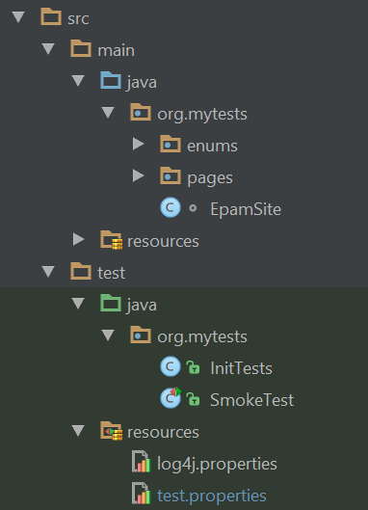
structure
test.properties
log properties
ui objects
test init
tests
data
utils

Slide 9
Page elements

Slide 10
Tests
Page Objects
Driver (Engine)
Application
PAGE OBJECTS
ELEMENTS
private WebElement UserName; private WebElement Password; private WebElement LoginButton;
ACTIONS
EnterUserName(String name);
EnterPassword(String name);
ClickLoginButton();
BUSINESS ACTIONS
Login(User user)

Slide 11
PAGE ELEMENTS
ELEMENTS
public TextField UserName; public TextField Password; public Button LoginButton;
ELEMENT
public DropDown UserStatus;
ACTIONS
Select(string option)
bool IsSelcted()
List<string> AllOptions()
string GetValue()
ACTIONS
---
BUSINESS ACTIONS
Login(User user)

Slide 12
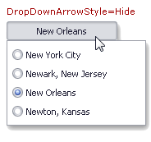
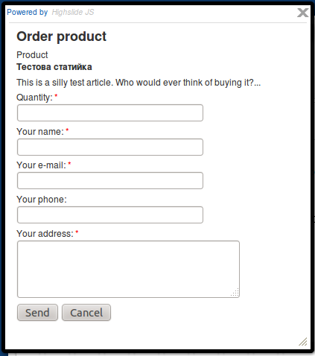

ELEMENTS
Simple
Complex
Composite

Slide 13
Simple elements

Slide 14


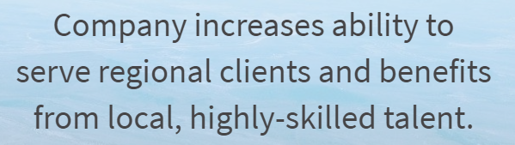
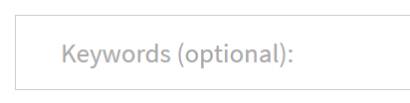
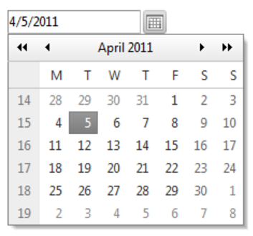



SIMPLE ELEMENTS
@FindBy (css=“.description”)
public Label productName;
public Text description;
public Image photo;
public TextField password;
public Button submit;
public Link followMe;
public TextArea abuse;
public CheckBox rememberMe;
public DatePicker date;
public FileInput upload;
NEWS

Slide 15
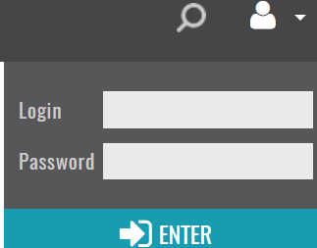
Login form
Textfield
public class LoginForm extends Form<User> {
@ById("Login") public TextField name;
@ById("Password") public TextField password;
@ByType("submit") public Button enter;
}
Button

Slide 16
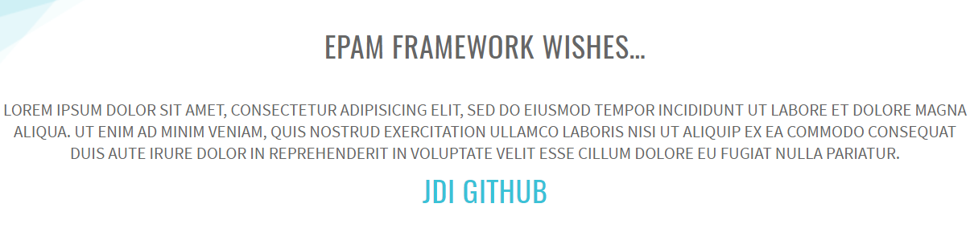

HOME PAGE
Image
Label
Text
Link
public class HomePage extends WebPage {
@ByClass("main-title") public ILabel title;
@Css(".main-txt") public IText mainText;
@Id("epam_logo") public IImage epamLogo;
@Text("JDI Github") public ILink jdiLink;
}

Slide 17
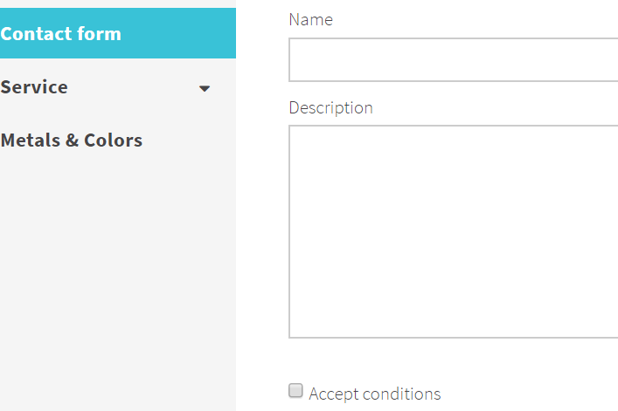
Contact form
public class ContactPage extends WebPage {
@ById("Description”) public ITextArea description;
@ById("accept-conditions") public ICheckBox acceptConditions;
}
TextArea
Checkbox

Slide 18
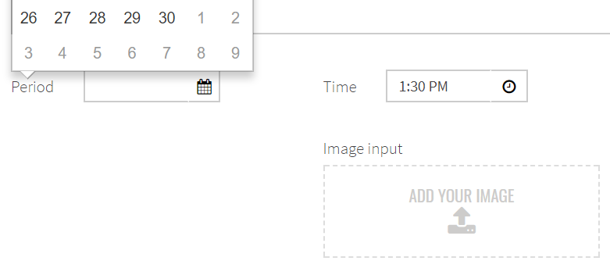
DATES PAGE
public class DatesPage extends WebPage {
@Css("#datepicker input") public IDatePicker date;
@ByText("Add your image") public RFileInput addFile;
}
FileInput
DataPicker

Slide 19
locators

Slide 20
DOM examples
<span>
<a class=”j-class” name=”j-name”, id=”j-id”>Click on link</a>
</span>
@FindBy (id = “j-id”)
@FindBy (className = “j-class”)
@FindBy (name = “j-name”)
@FindBy (linkText = “Click on link”)
@FindBy (partialLinkText = “link”)
@FindBy (tagName = “a”)

Slide 21
DOM pros and cons
Pros | Cons
Fast search Simple locators | No flexibility Can’t go down in html tree Can’t go up in html tree Can use only specified attributes Can’t search list of tags/attributes No ability to search by text (except link text) Can’t search for contains or match No ability to get one of elements from list

Slide 22
CSS examples
<span>
<a class=”j-class” name=”j-name”, id=”j-id”>Click on link</a>
</span>
@FindBy (css = “a[name=‘j-name’]”)
@FindBy (css = “span a[class=‘j-class’]”)
@FindBy (css = “span [id*=‘id’]”)
@FindBy (css = “[name$=‘name’]”)
@FindBy (css = “#j-id”)
@FindBy (css = “.j-class”)
@FindBy (css = “[name=‘j-name’]”)
@FindBy (css = “a”)
https://www.w3schools.com/cssref/css_selectors.asp

Slide 23
CSS pros and cons
Pros | Cons
Fast search (slightly slower than dom) Easy and flexible search Can go down in html tree You can search by any tag or attribute Or even combine them in one search Shorten view for: id (#) and class (.)) Possible to search by contains or regex | No ability to search by text No ability to go up in html No ability to get one of elements from list

Slide 24
XPATH examples
https://www.w3schools.com/xml/xpath_syntax.asp
<span>
<a class=”j-class” name=”j-name”, id=”j-id”>Click on link</a>
<a class=”j-class” name=”j-name”, id=”j-id”>Click on link</a>
</span>
@FindBy (xpath = “//*[@id=‘j-id’]”)
@FindBy (xpath = “//*[@class=‘j-class’]”)
@FindBy (xpath = “//*[@name=‘j-name’]”)
@FindBy (xpath = “//a[text()=‘Click on link’]”)
@FindBy (xpath = “//a[contains(.,‘Click on link’)]”)
@FindBy (xpath = “a”)
@FindBy (xpath = “//a[@name=‘j-name’]”)
@FindBy (xpath = “//span//a[@class=‘j-class’]”)
@FindBy (xpath = “//span//*[contains(@id, ‘id’)]”)
@FindBy (xpath = “//*[ends-with(@name, name)]”)
@FindBy (xpath = “//*[@id=‘j-id’]//..//”)
@FindBy (xpath = “//*[@class=‘j-class’][2]”)

Slide 25
XPATH pros and cons
Pros | Cons
Ability to perform aby possible search Can go down in html tree Can go up in html tree /../ or div[span[text()=‘test’]] You can search by any tag or attribute Or even combine them in one search Possible to search by contains or regex You can search by text text()=‘test’ or .=‘test’ Possible to select any element from list by index [2] | Slowest search (but fast enough if keep in mind long page load time) Complex locators view (but really obvious)

Slide 26
locators
DOM
id, className, name, linkText, partialLinkText
Fast, short, limited
CSS
.user span[type=login]
Average speed, short, flexible
XPATH
//*[@class=‘user’]//span[@type=‘login’]
LowSpeed, long, universal

Slide 27
Good locators
Obvious
Search speed not the argument because of to much time on page load. But obvious locators saves your time on issue identification
Optimal
Use dom locators while you have good ids or names
Best way to use css in most cases except you search by text or need to go up in html tree
In other cases use xpath. Always keep in mind that locator should be obvious so even if your element has id but more obvious will be xpath then use xpath
<span id=”lt-list”>
<p>
<label>Coal</label>
<input id=”lt-button1”/>
</p>
…
</span>
@FindBy (xpath = “//label[text()=’Coal’]//../input”) - correct
@FindBy (id = “lt-button2”) – wrong

Slide 28
Locator AnnotationS
@FindBy (css=“.btn”)
public Button submit;
Angular
Selenium
@FindBy (model=“btn-model”)
@FindBy (binding=“btn”)
@FindBy (repeat=“r-button”)
@JFindBy (text=“Submit”)
@JFindBy(name=“Submit”)
@JFindBy(value=“Submit”)
@JFindBy(title=“Submit”)
@JFindBy(type=“Submit”)
@Css(“.submit”)
@XPath(“.submit”)
@Tag(“button”)
@ByText(“Test”)
@ByValue(“st”)
@ByType(“//button”) @ByTitle(“submt-id”)
@FindBy (css=“.btn”)
public Button submit =
new Button(By.css(“.btn”));
Special
@FindBy (css=“.btn”)
public IButton submit;

Slide 29
NEXT
JDI Intro
JDI UI objects and Complex elements
JDI Tables and custom elements
JDI Settings. EDT. DDT. Test runs
Around JDI. Reports. Logs. Grid. Asserts

Slide 30
HOMEWORK
Fork/download JDI template
https://github.com/epam/JDI-Examples
Write your few tests on JDI
Test site: https://epam.github.io/JDI/
Login: epam ; psw: 1234
Try to use all types of simple elements from slides

Slide 31



Questions
roman.iovlev
roman.iovlev.jdi@gmail.com

